Slide 3
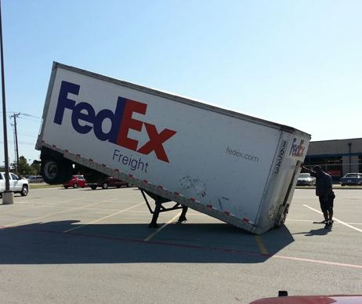
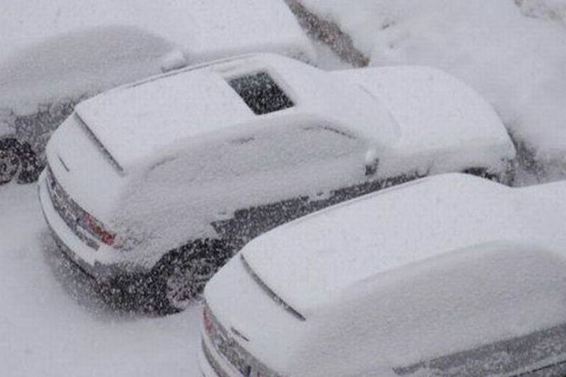

Slide 4
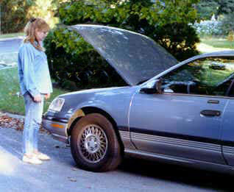
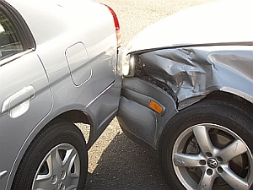
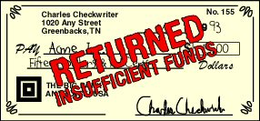

Slide 5
David and the People, 1 Samuel 30:3-4
The Godly Man Job, Job 1:13-21; 2:7
The Prophet Ezekiel, Ezekiel 24:15-18
Good King Hezekiah, 2 Kings 19:8-13
The Thief on the Cross, Luke 23:39-43

